Slide 1
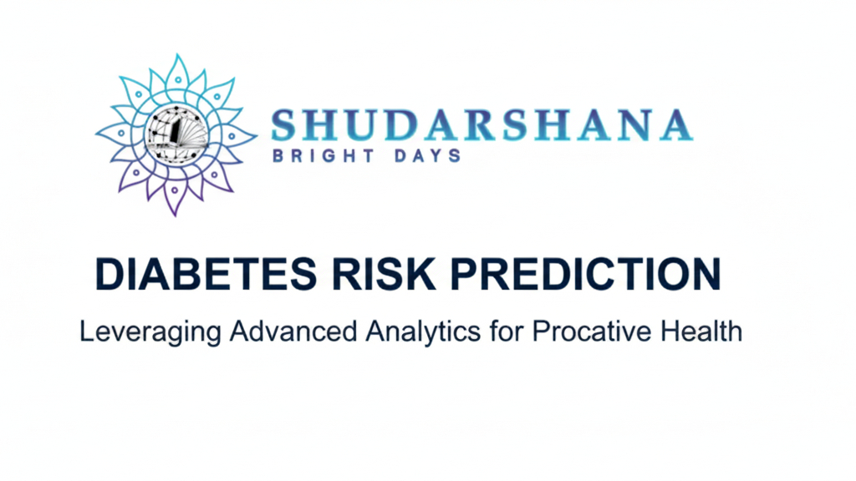



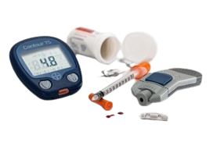
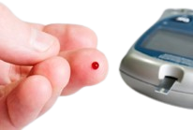

Slide 2
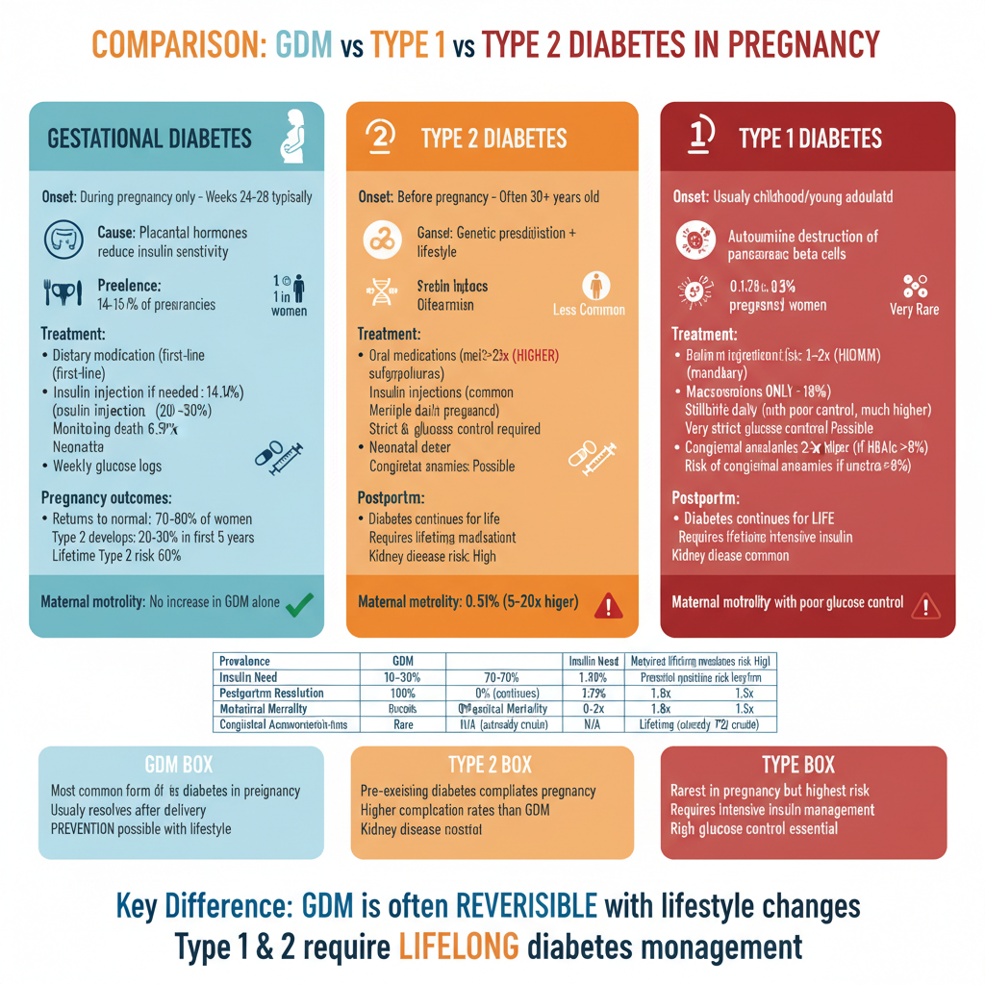
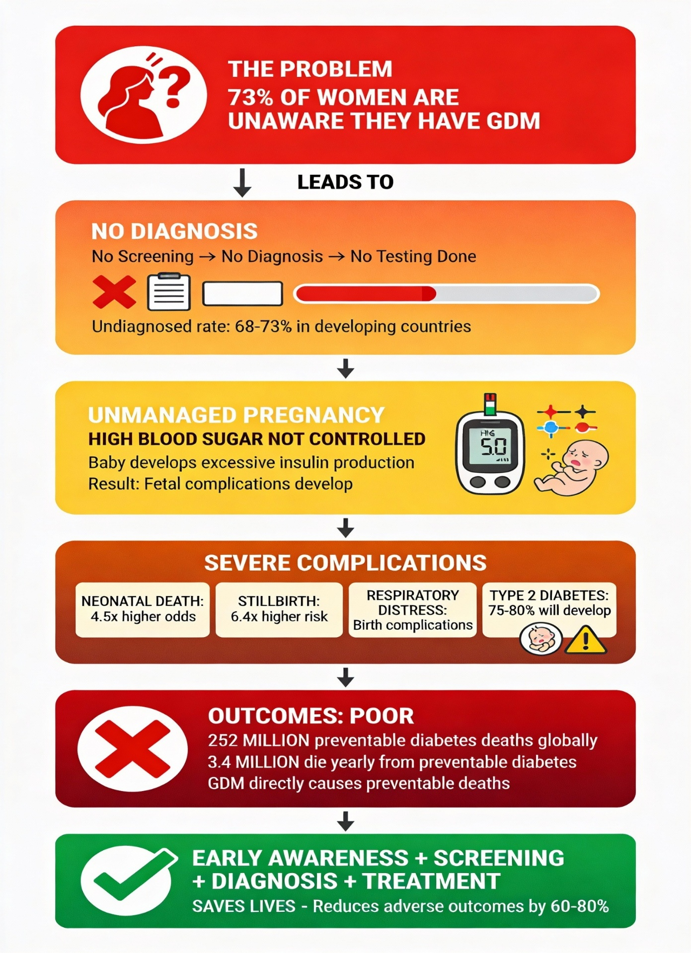
HEALTHCARE
the research

Slide 3
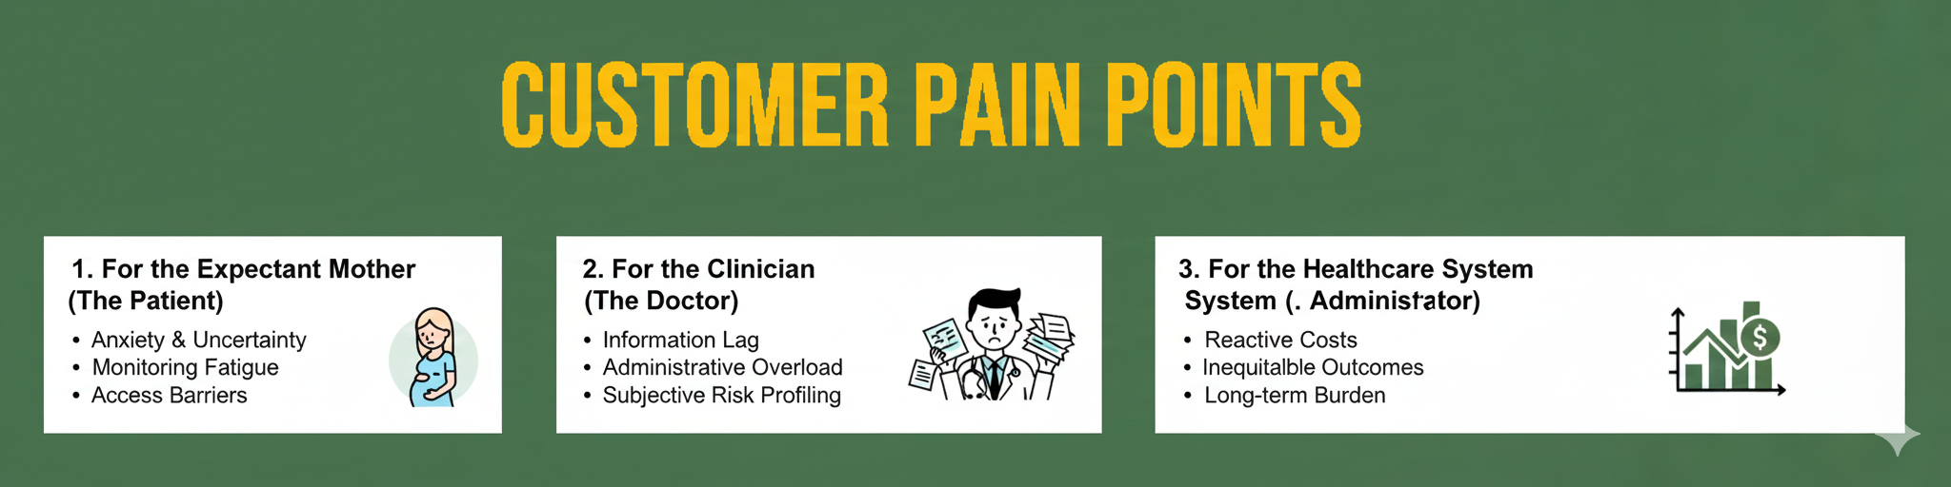
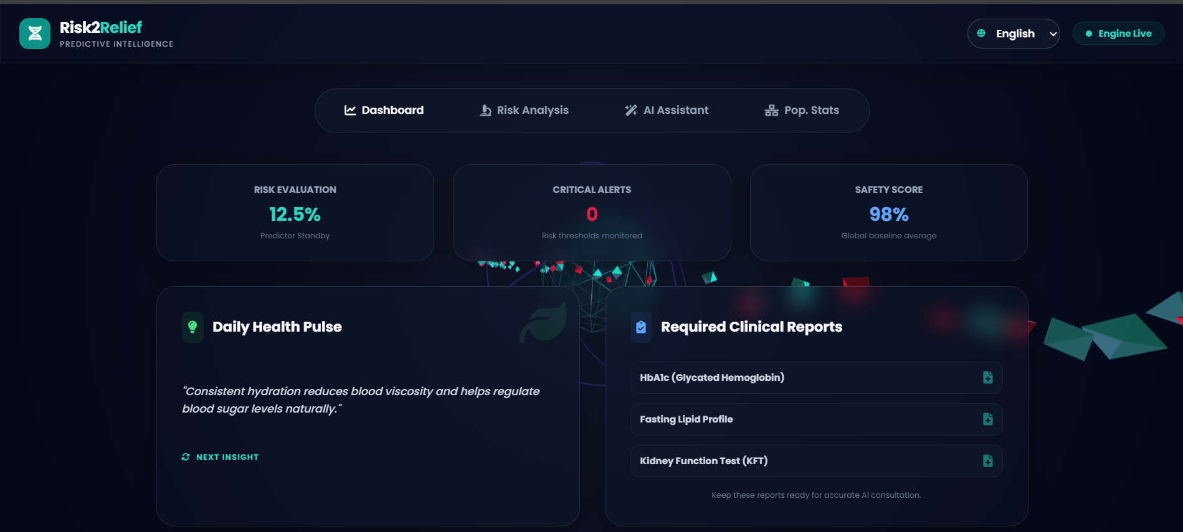

Slide 4
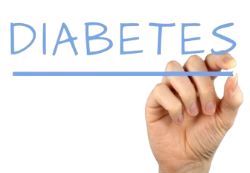
The problem
Problem Statement
In the current healthcare landscape, Gestational Diabetes Mellitus (GDM) and maternal health complications often go undetected until they reach a critical stage, particularly in underserved or rural areas. Traditional diagnostic methods are frequently hindered by several "pain points" identified in clinical research:
Delayed Triage: Manual clinical screenings are time-consuming and often occur too late to prevent preventable maternal morbidity.
Subjectivity in Risk Assessment: Relying solely on static factors like age and BMI leads to subjective interpretations and a high rate of missed early-warning signs.
Resource Disparity: Roughly 287,000 to 300,000 women die annually from pregnancy-related causes, with rural populations being nearly twice as likely to suffer fatal outcomes due to a lack of specialized diagnostic tools and obstetricians.
Data Fragmentation: Clinicians often lack a unified system to process bulk patient data rapiadly, leading to "maternity care deserts" where high-risk patient clusters remain invisible to health administrators.

Slide 5
Our solution
Theoretical Framework: Meta-AI for GDM Risk Stratification
1. The Core Problem
The system addresses the critical gap in Gestational Diabetes Mellitus (GDM) diagnostics. Traditional methods suffer from Delayed Triage and Subjectivity, particularly in "maternity care deserts." By the time GDM is manually diagnosed via routine screenings, the risk of maternal and neonatal morbidity has often already escalated.
2. The Solution Architecture: "Weighted Fusion"
Our solution moves beyond simple binary classification. It utilizes a Meta-AI Decision engine that aggregates intelligence from three distinct algorithmic "streams." This mimics a medical board where multiple specialists (the models) provide opinions, and a lead consultant (the Meta-AI) makes the final call based on the reliability of each specialist.
3. The Three Intelligence Streams
Each stream analyses the patient's vitals (Glucose, BMI, Age, etc.) through a different lens:
Classical ML Stream: Likely using algorithms like Random Forest or Logistic Regression. This provides a robust baseline based on historical statistical patterns.
Artificial Neural Network (ANN) Stream: Deep learning layers that capture non-linear relationships and complex interactions between variables (e.g., how Age combined with Insulin levels increases risk exponentially).
Quantum-Logic Stream (Simulated): In your code, this is represented as a transformation of the classical output ($P_{ml} \times 0.95$). Theoretically, this represents high-dimensional optimization, finding "shortcuts" in the data features that traditional models might miss.

Slide 6
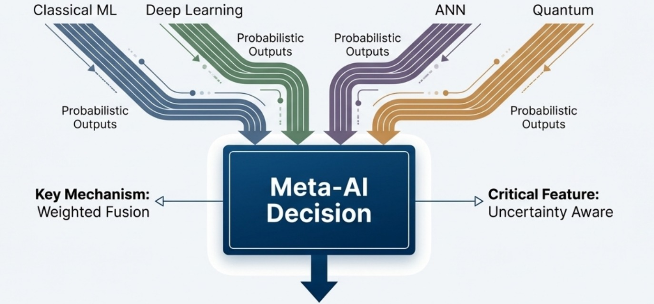

Slide 7
Our solution
Technical Mechanism
Data Processing & Normalization
The system employs a StandardScaler. This is crucial because clinical parameters have vastly different scales (e.g., Glucose might be 150, while DPF is 0.5). Without scaling, the model would mistakenly prioritize the feature with the higher numerical value rather than the higher clinical significance.
Meta-AI Decision Engine
Instead of just averaging the scores, your system uses Weighted Fusion. The Meta-AI model (meta_ai.joblib is trained to know which stream is most accurate under specific conditions.
Uncertainty Awareness: By calculating the standard deviation (sigma) between the three streams, the system measures "model discordance." If the streams disagree significantly, the uncertainty score rises, signaling that the case requires human clinical oversight.
Final Risk = f(Pclassical, Pann, Pquantum)
The User Interface (Holographic Clinical Suite)
The frontend serves as a Decision Support System (DSS). It translates complex probabilities into:
Visual Risk Gauges: Immediate visual cues for clinicians.
Multilingual Accessibility: Bridging the gap in rural areas by supporting English, Telugu, and Hindi.
Conversational AI: Using the Gemini API to provide educational dietary and lifestyle interventions, turning "data" into "actionable advice."

Slide 8
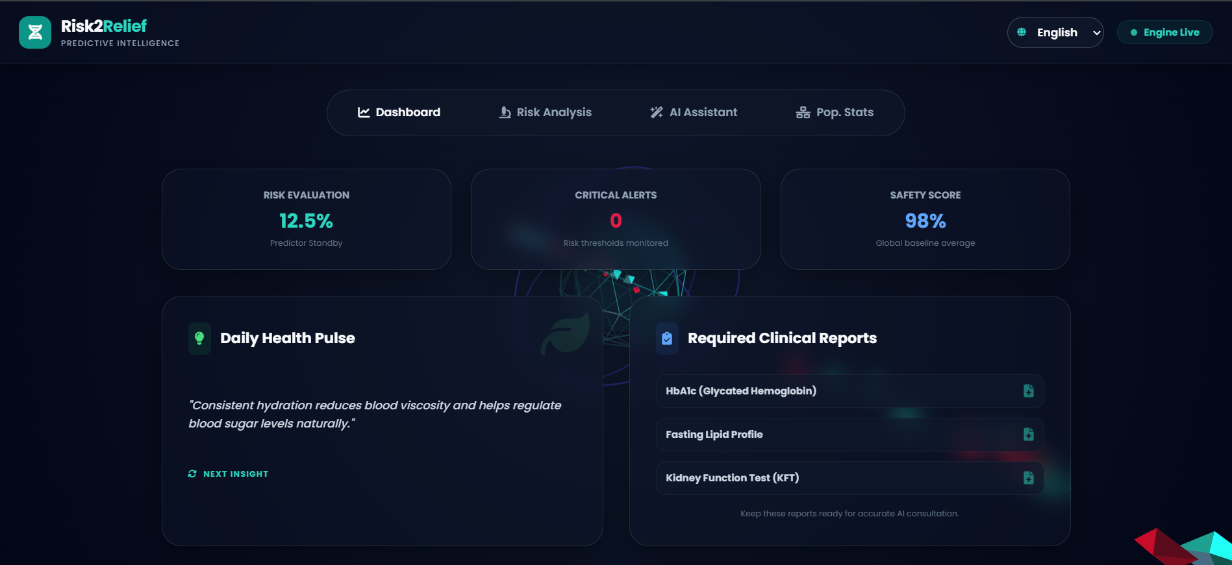
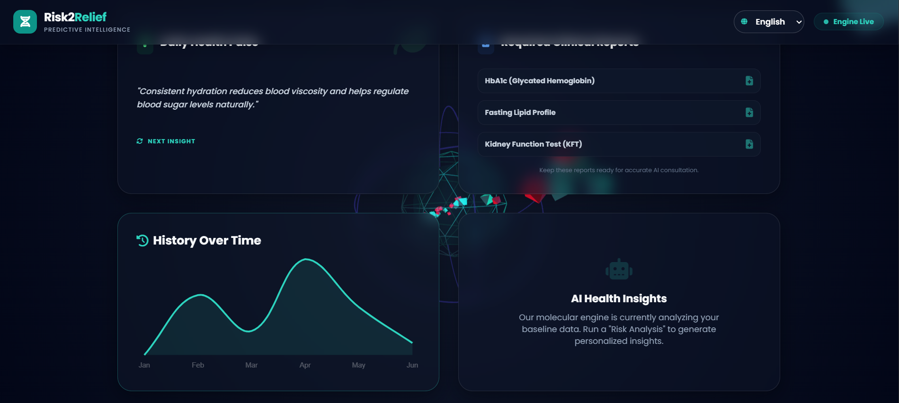
Minimum viable product
Platform preview ✨
1
Home page
2
Explore concepts

Slide 9
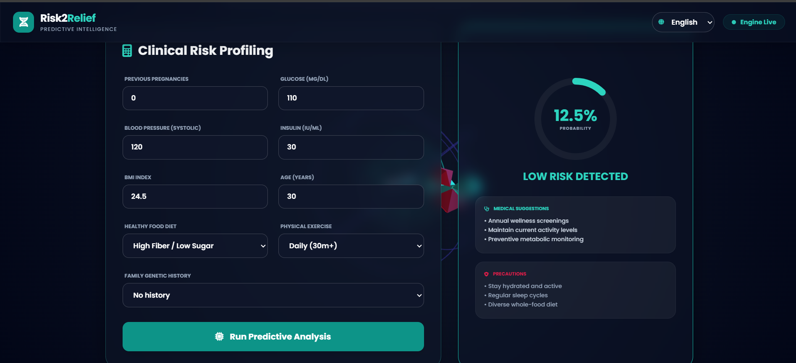
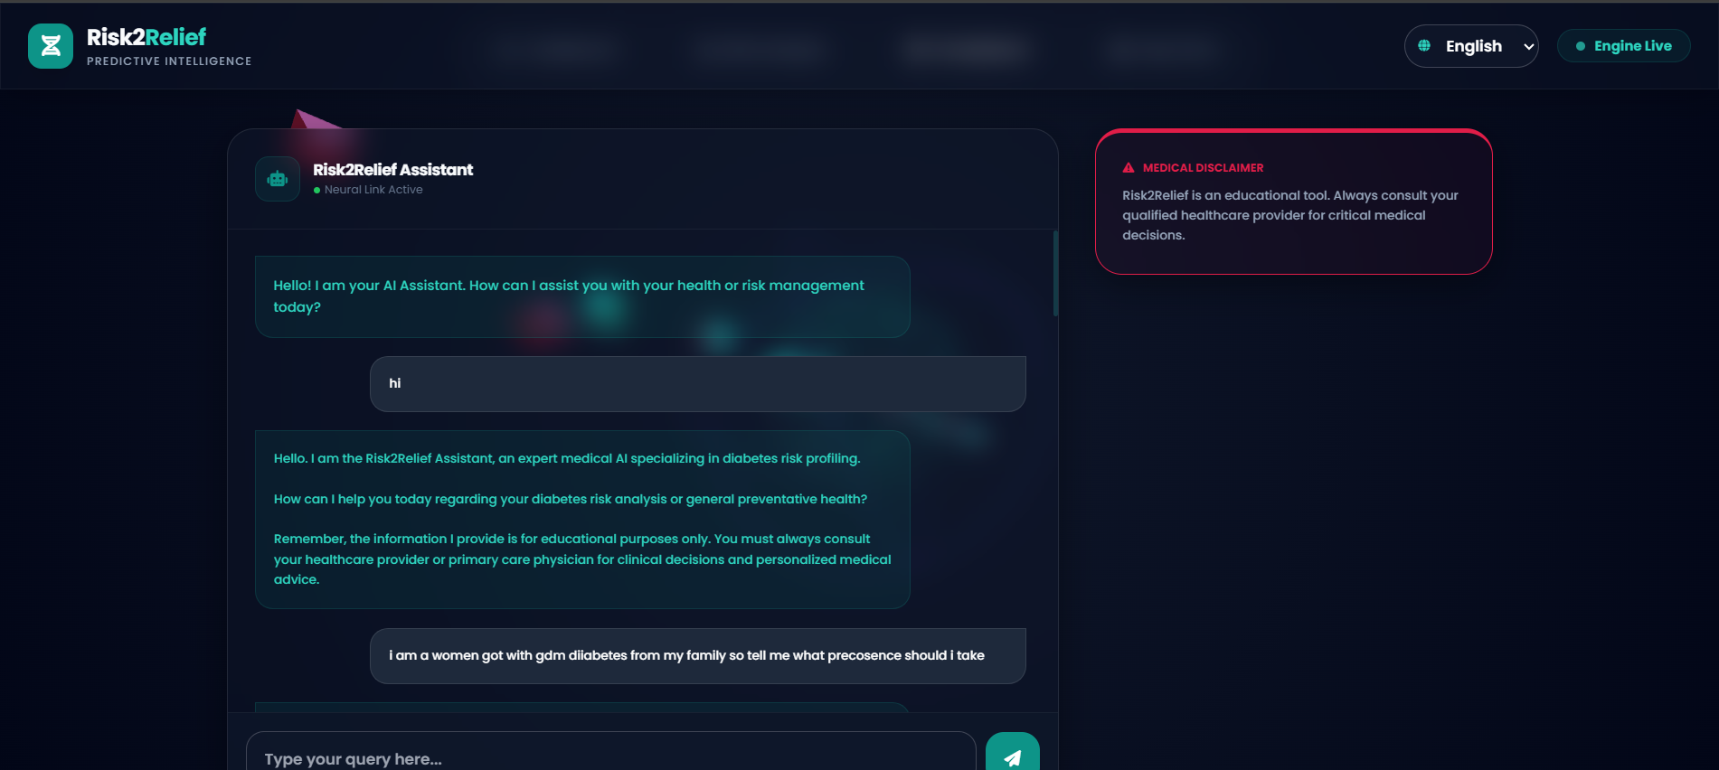
3
Explore concepts
4
Explore concepts

Slide 10
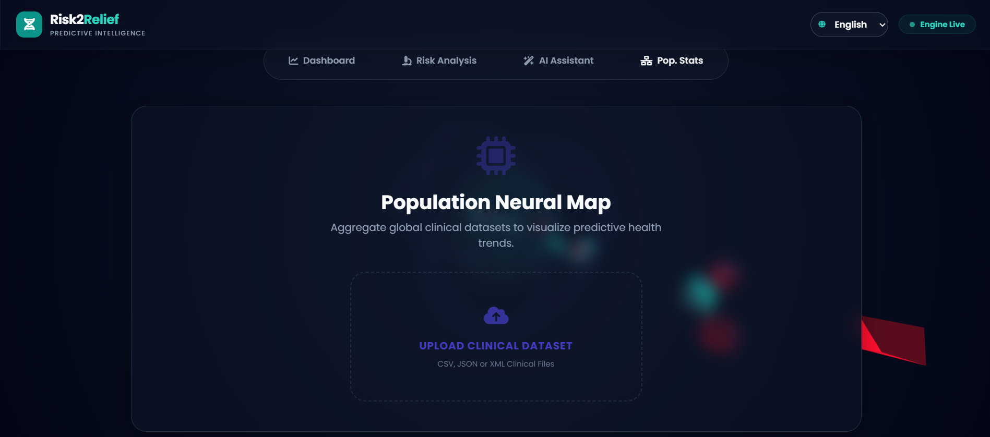
Minimum viable product
Platform preview ✨
5
Explore concepts

Slide 11
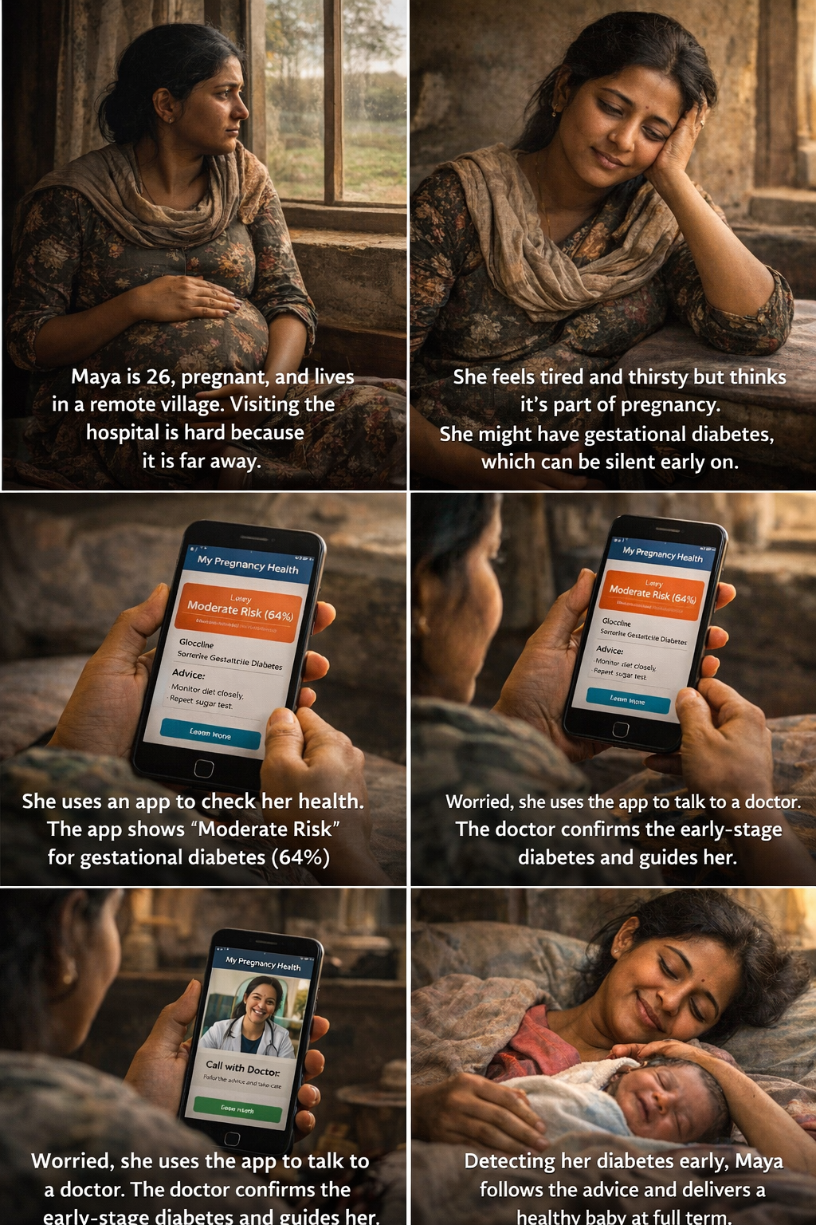
Use Cases
The STORY

Slide 12
What we offer
Predictive Intelligence: A molecular engine that analyzes baseline data to generate personalized health insights.
Clinical Risk Profiling: Specialized analysis to detect low, moderate, or high risk for conditions like diabetes.
Preventative Guidance: Expert-level medical suggestions and precautions based on individual bio-data.
Centralized Patient Management: A unified dashboard to track total patients analyzed and high-risk cases.
Our features
Core Features
Advanced Dashboard: Real-time tracking of Risk Evaluations, Critical Alerts, and Safety Scores compared to global averages.
Bio-Data Processing: In-depth analysis of clinical metrics like Glucose, BMI, Blood Pressure, and Insulin levels.
Clinical History Tracking: Visual "History Over Time" graphs to monitor health trends across several months.
AI Assistant: A "Neural Link Active" chatbot for expert medical consultations on risk analysis and preventative care.
Population Analytics: A Population Neural Map to aggregate global datasets (CSV, JSON, or XML) for visualizing health trends.
Required Report Integration: Automated prompts for essential tests like HbA1c, Lipid Profiles, and KFT.

Slide 13


Customer value proposition
For Healthcare Providers: It offers a high-speed analytical tool to monitor patient populations, identify high-risk cases instantly, and track longitudinal health trends through visual data mapping.
For Patients: It provides personalised risk transparency, enabling individuals to understand their health trajectory and receive tailored preventative suggestions.
For Organizations: It enables large-scale population health analysis by aggregating global clinical datasets to visualise and predict broader disease trends.
Our product
Predictive Logic Engine (Classical & ANN Streams, Simulated Quantum Path)
Comprehensive Analysis Dashboard (Risk Evaluation & Safety Scores, History Over Time, Required Clinical Reports)
Intelligent Interaction & Reporting (Risk2Relief AI Assistant, Population Neural Map, Daily Health Pulse)

Slide 14
Competitive analysis
Comparison Feature | Traditional Clinical Care | Basic Glucose Apps | Standard Telehealth | Wearable Sensors (CGM) | Our Solution
Real-Time Data Sync | ❌ | ✅ | ✅ | ✅ | ✅
Automated Clinical Triage | ❌ | ❌ | ❌ | ❌ | ✅
Early Risk Prediction | ❌ | ❌ | ❌ | ❌ | ✅
Remote Patient Monitoring | ❌ | ✅ | ✅ | ✅ | ✅
Postpartum Follow-up | ❌ | ❌ | ❌ | ❌ | ✅
Low-Cost Accessibility | ✅ | ✅ | ❌ | ❌ | ✅
Unified System for Clinics | ❌ | ❌ | ✅ | ❌ | ✅

Slide 15





thE TEAM
Team Shudarshana. Our mission is to combine technical innovation with rigorous research to provide a clear, data-driven vision for diabetes management. Inspired by the precision of the Sudarshana, we cut through complex data to deliver meaningful health solutions and awareness."
Uttej Moturu
Kasi Viswanath Vegisetti
Agraharapu Haripriya
Dasari Tarun Kumar
Team Leader
Tech Developer
UI Developer
Literature Reviewer
The Anchor: Responsible for overall project coordination, timeline management, and ensuring that every team member’s work aligns with the project’s goal of diabetes education and analysis.
The Engine: manages the technical implementation, including any data processing, algorithmic analysis, or coding required to transform raw health data into usable insights.
The Bridge: Focuses on the "Vision" (Darshana) aspect of our name. She translates complex technical results into a user-friendly and visually engaging interface, making the information accessible to everyone.
The Foundation: Conducts deep-dive research into medical journals, news reports, and academic papers. He ensures the project is built on a foundation of verified facts regarding diabetes trends, risks, and management strategies.

